Slide 1

NLP SENTIMENT ANALYSIS
Under Guidance of: Ms. Bhanu Priya
Project By:
Jeshma Hasti
Ramireedy Vara Lakshmi Devika
Avulapati Swetha
Vaishnavi Abhimanyu Sonune
Kante Sampath Kumar
H Shreyank
A Dhananjaya Kumar

Slide 2
Contents
BUSINESS OBJECTIVE
APPROACH
SELECTING BEST MODEL
MODEL DEPLOYMENT
RESULTS

Slide 3
BUSINESS OBJECTIVE
Sentiment analysis looks at the emotion expressed in a text. It’s a form of text analytics that uses natural language processing (NLP) and machine learning. Sentiment analysis is also known as “opinion mining” or “emotion artificial intelligence”.
The goal here is used to determine whether a given text contains negative, positive emotions
Approach
Web scraping.
Import the dataset.
Exploratory Data Analysis & Visualization.
Text preprocessing.
Feature Extraction
Sentiment Analysis
Selecting Best Model
Model Deployment

Slide 4
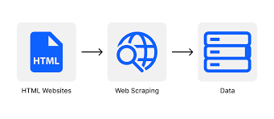
Web Scraping
Web scraping is the process of collecting unstructured and structured data in an automated manner.
Web scraping Process:
Identify the target website
Collect URLs of the target pages
Make a request to these URLs to get the HTML of the page
Use locators to find the information in the HTML
Save the data in a JSON or CSV file or some other structured format.

Slide 5
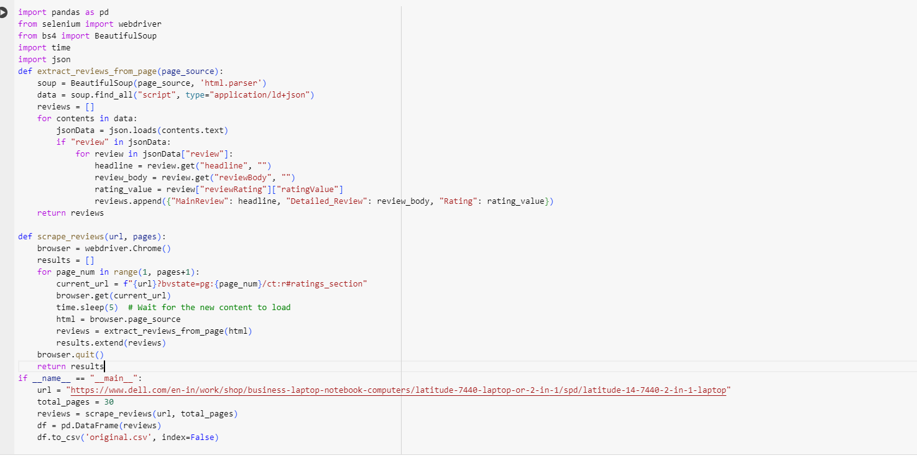

Slide 6
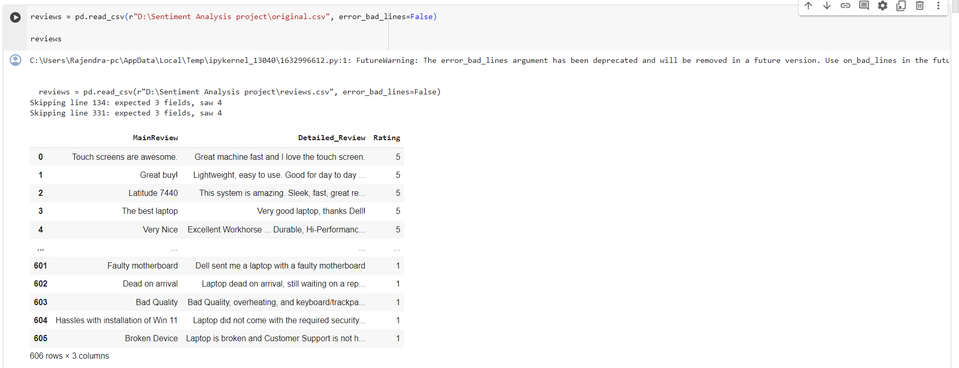
Import the dataset

Slide 7
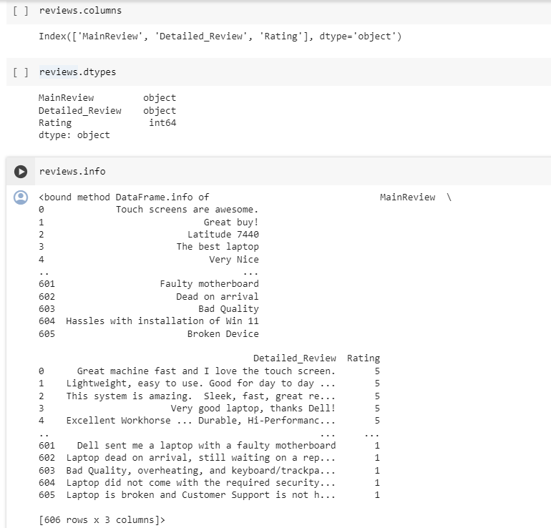
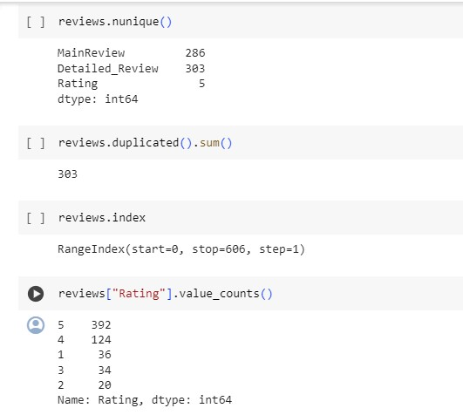
Data Pre-Processing
.coloums-it returns the names of the columns present in that data frame.
.dtypes-to get the data types of each column.
.info-method in pandas is used to print a concise summary of a data frame.
.nunique()- used to count the number of unique values in a data frame.
.index-used for identifying each row or element uniquely.

Slide 8
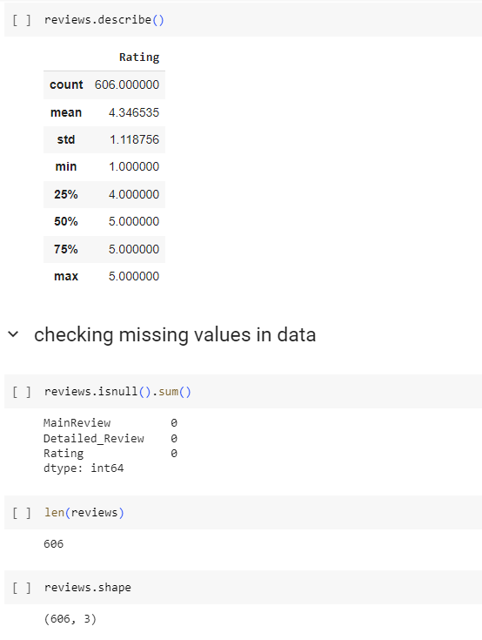
Data Pre-Processing(contd)
.describe-used to generate descriptive statistics.
.isnull().sum()-used to count the number of missing or NaN values across the data frame.
.shape-used to get the dimensions of an array or data frame.

Slide 9
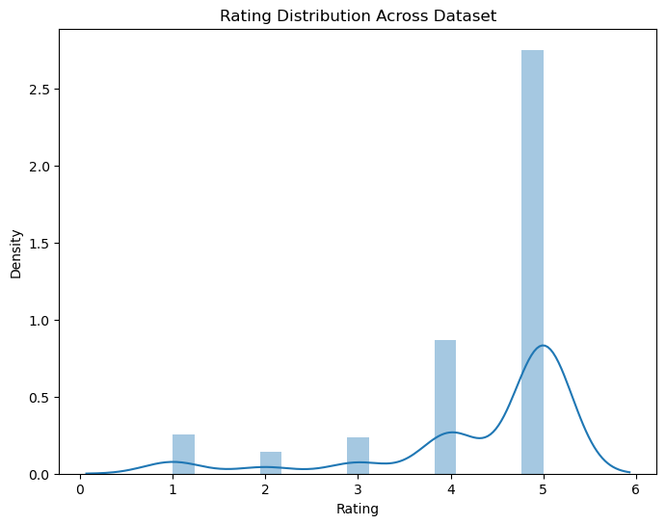
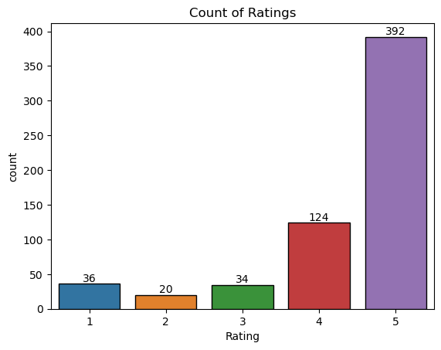
Exploratory Data Analysis & Visualization
Libraries used:
Seaborn
Matplotlib.pyplot
Histogram for Count of the ratings
Count Plot for Count of the ratings

Slide 10
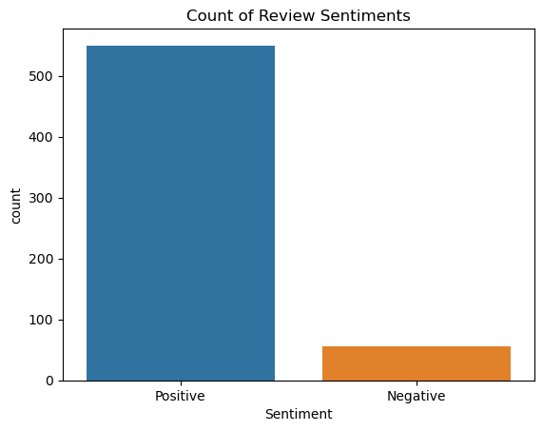
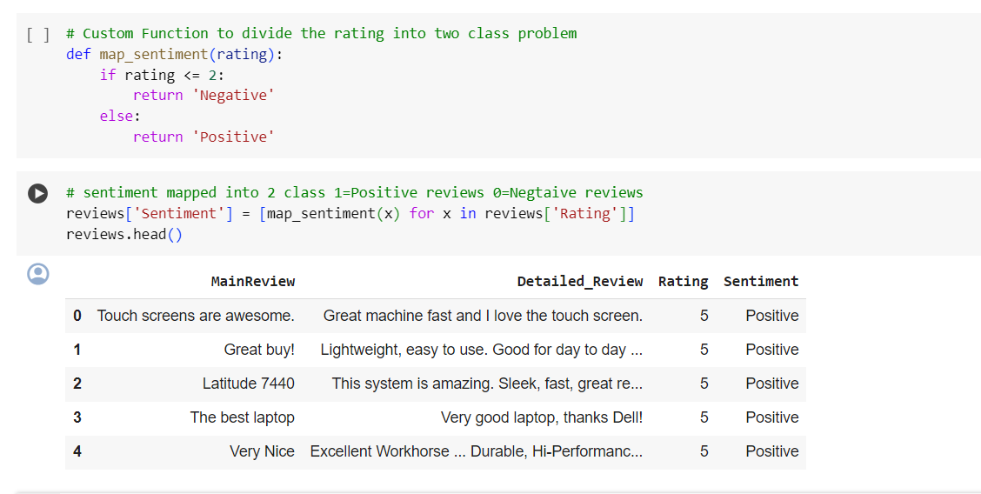
EDA & Vizualization(contd)
Sentiment mapped into 2 classes:
If the rating is more than 2 is sentiment “POSITIVE”.
If the rating is less than 2 or equal is sentiment “NEGATIVE”.

Slide 11
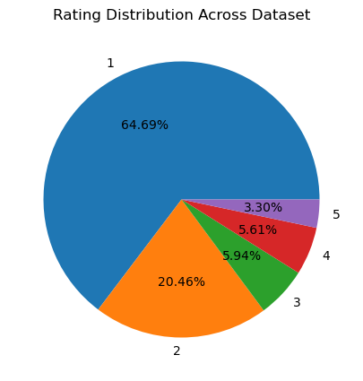
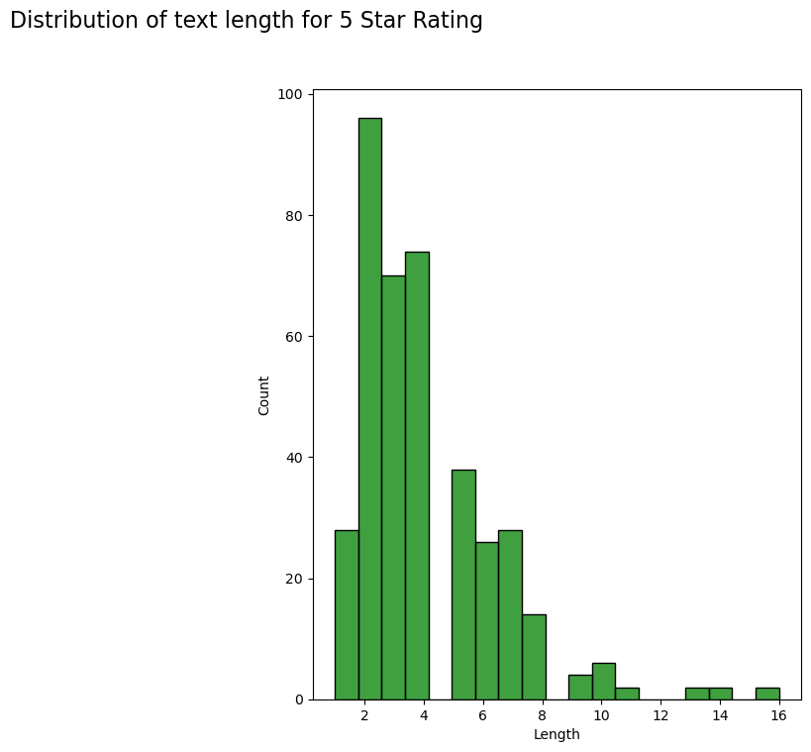
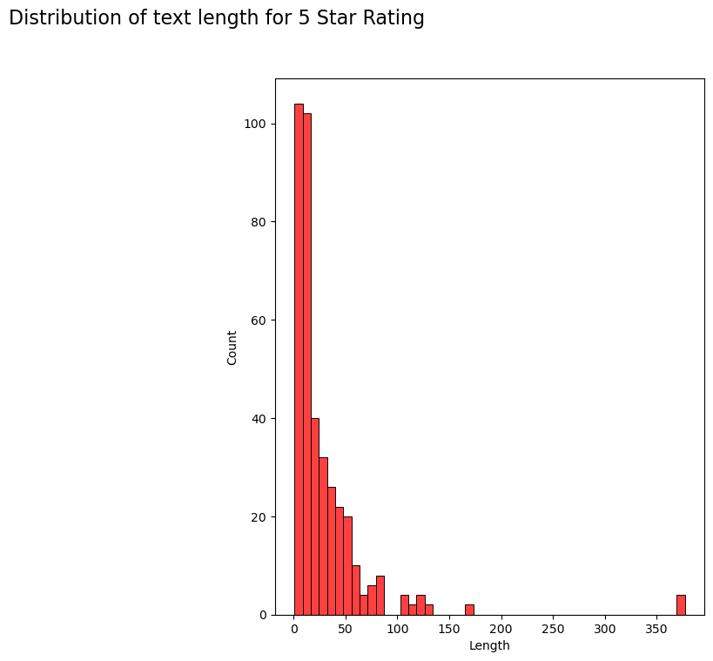
Exploratory Data Analysis(contd)
Pie chart for Rating Distribution Across Dataset
To display descriptive statistics for the length of reviews (Main_Reviews) with a 5-star rating
Display descriptive statistics for the length of reviews(Detailed_Reviews) with a 5-star rating

Slide 12
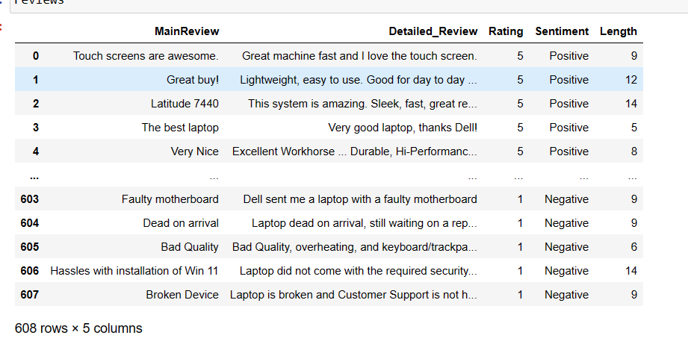
Text Pre-Processing
Tokenization
The length of the Detailed_Review after tokenization as shown below:
Tokenization is breaking the documents or sentences into chunks called tokens. Each token carries a semantic meaning associated with it.
Libraries used:
import nltk
nltk.download('punkt')
from nltk.tokenize
import word_tokenize

Slide 13
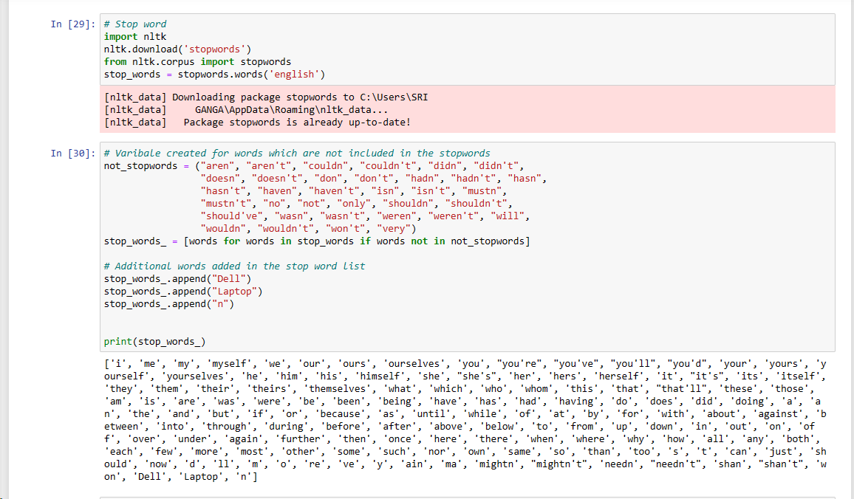
Text Pre-Processing
Stop Words

Slide 14
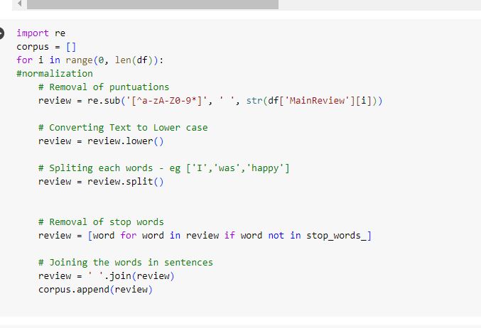
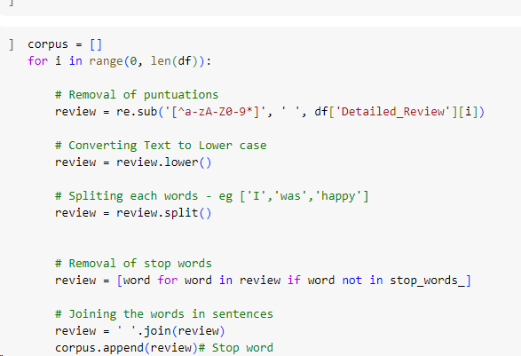
Text Pre-Preprocessing
Normalization

Slide 15
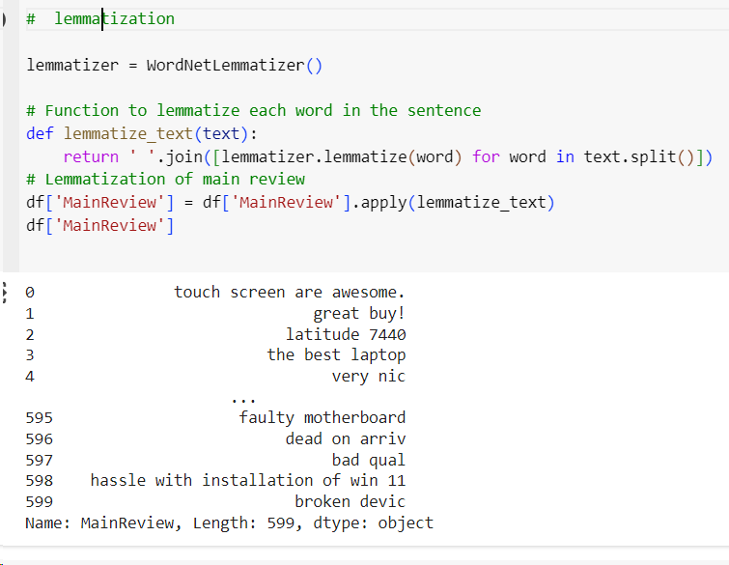
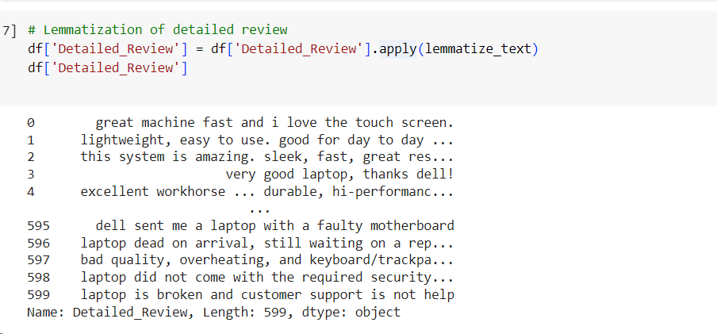
Text Pre-Processing(contd)
Lemmatization:The context and part of speech of a word in a sentence to return the base or dictionary form of a word

Slide 16
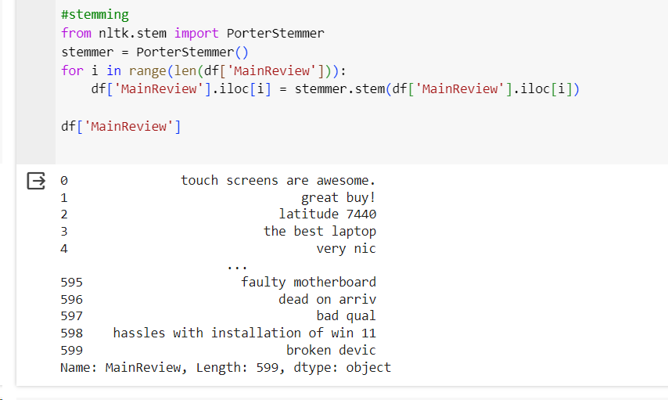
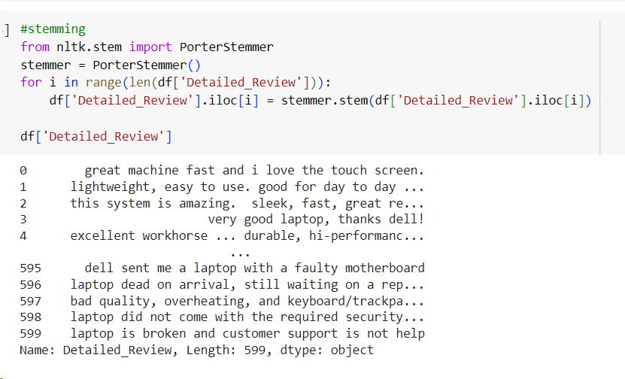
Text Pre-Preprocessing
Stemming: It reduces words to their base or root form, often by removing common prefixes and suffixes.

Slide 17
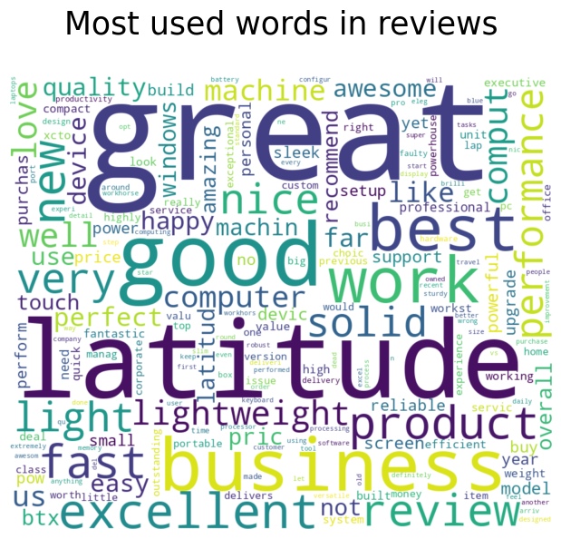
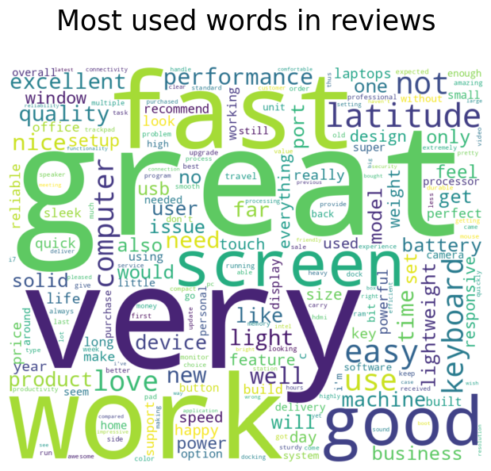
Word Cloud
In MainReview
In Detailed_Review

Slide 18
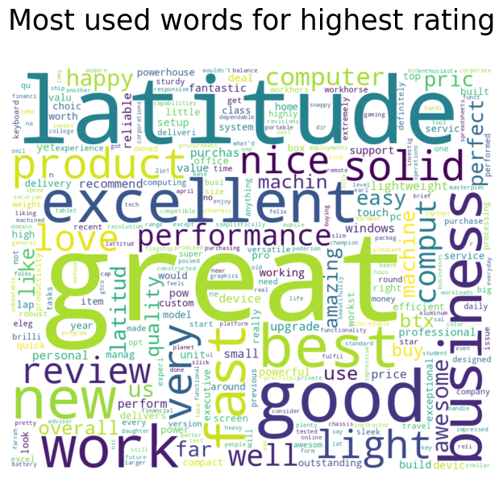
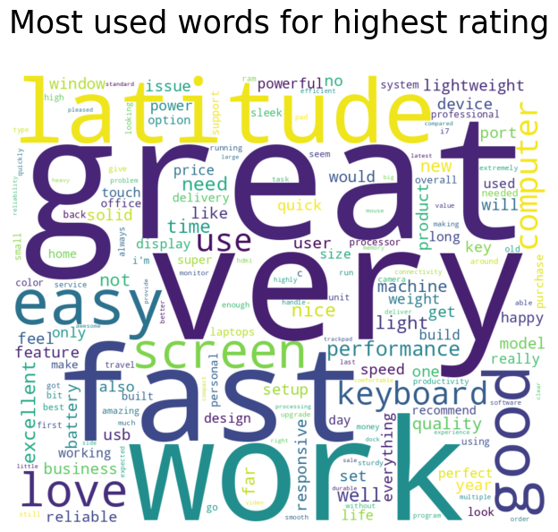
Word Cloud(contd)
For Detailed_Review
For MainReview

Slide 19
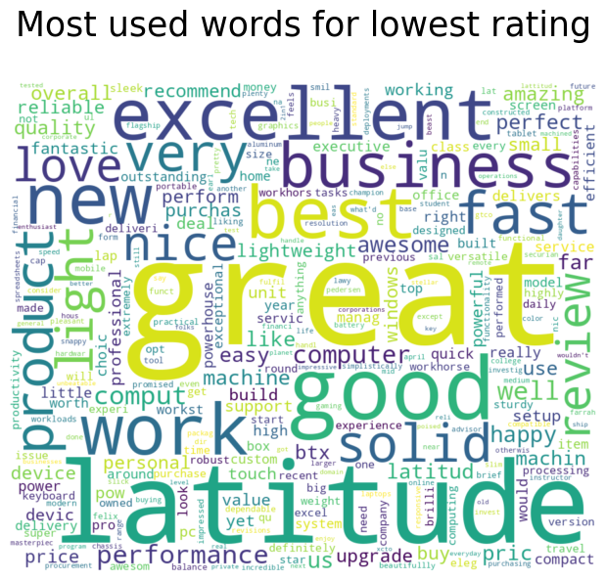
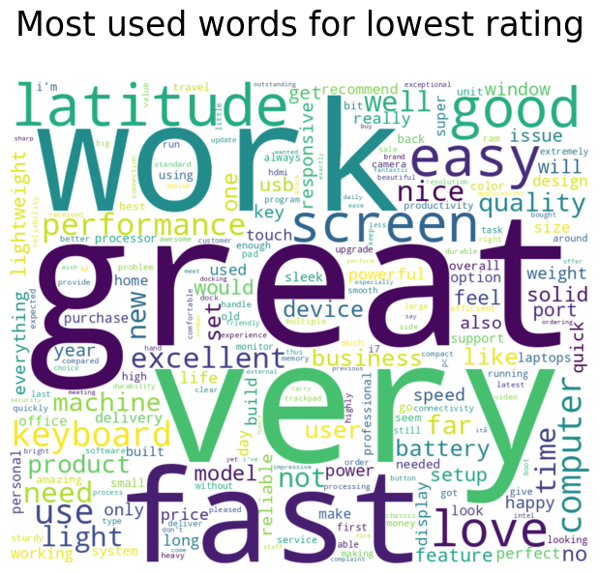
Word Cloud(contd)
For MainReview
For Detailed_Review

Slide 20
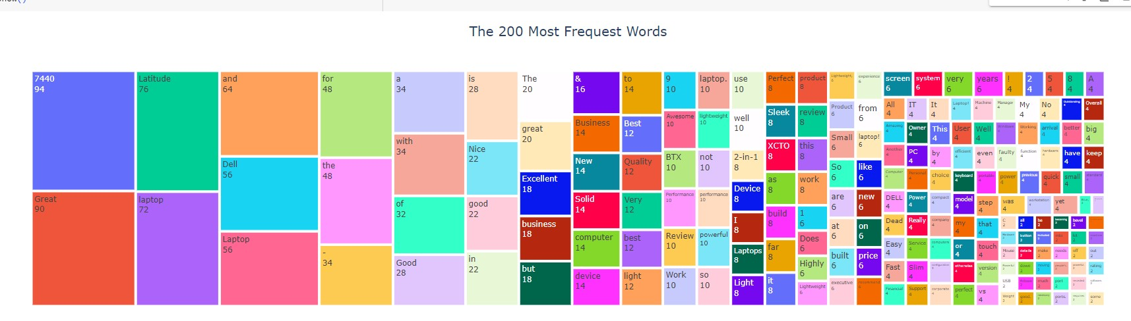
WORD CLOUD(contd)
Count of most frequent words In MainReview

Slide 21
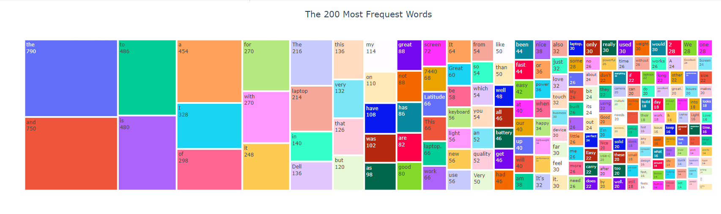
WORD CLOUD(contd)
Count of most frequent words In Detailed_Review

Slide 22
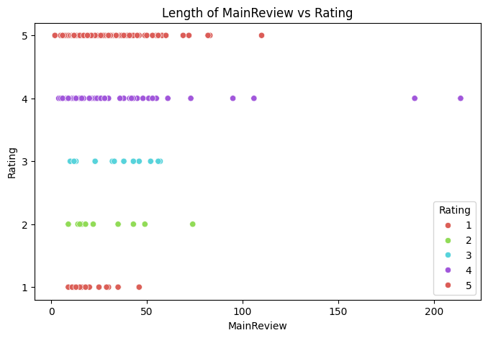
The length of words in a review for all the rating

Slide 23
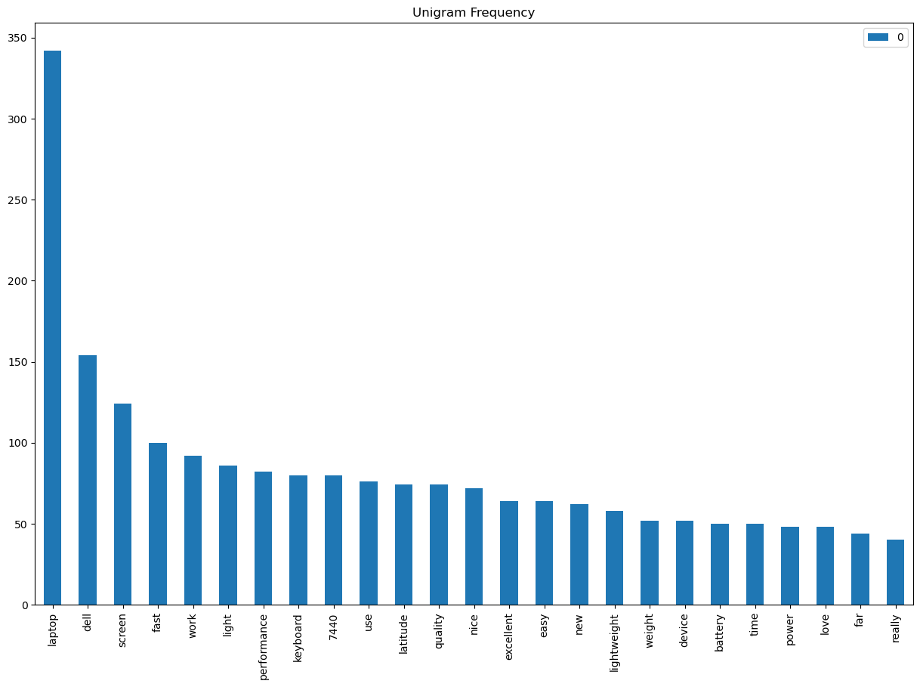
Count vectorizer
Feature Extraction(contd)
Unigram: is a single word sequence of word.
Count Vectorizer is a text analysis tool that converts text data into numerical vectors based on word frequency counts.
Libraries used:
from sklearn.feature_extraction.text import CountVectorizer

Slide 24
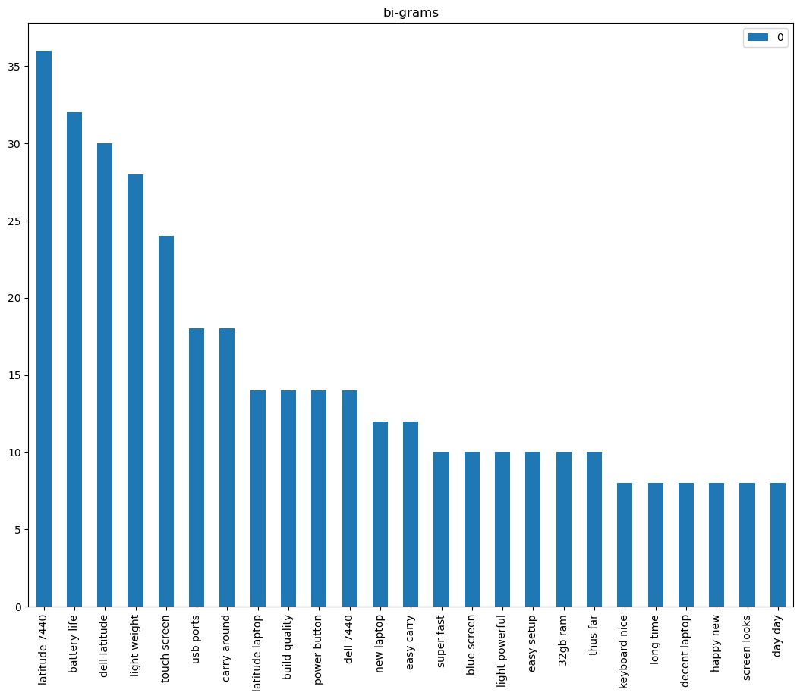
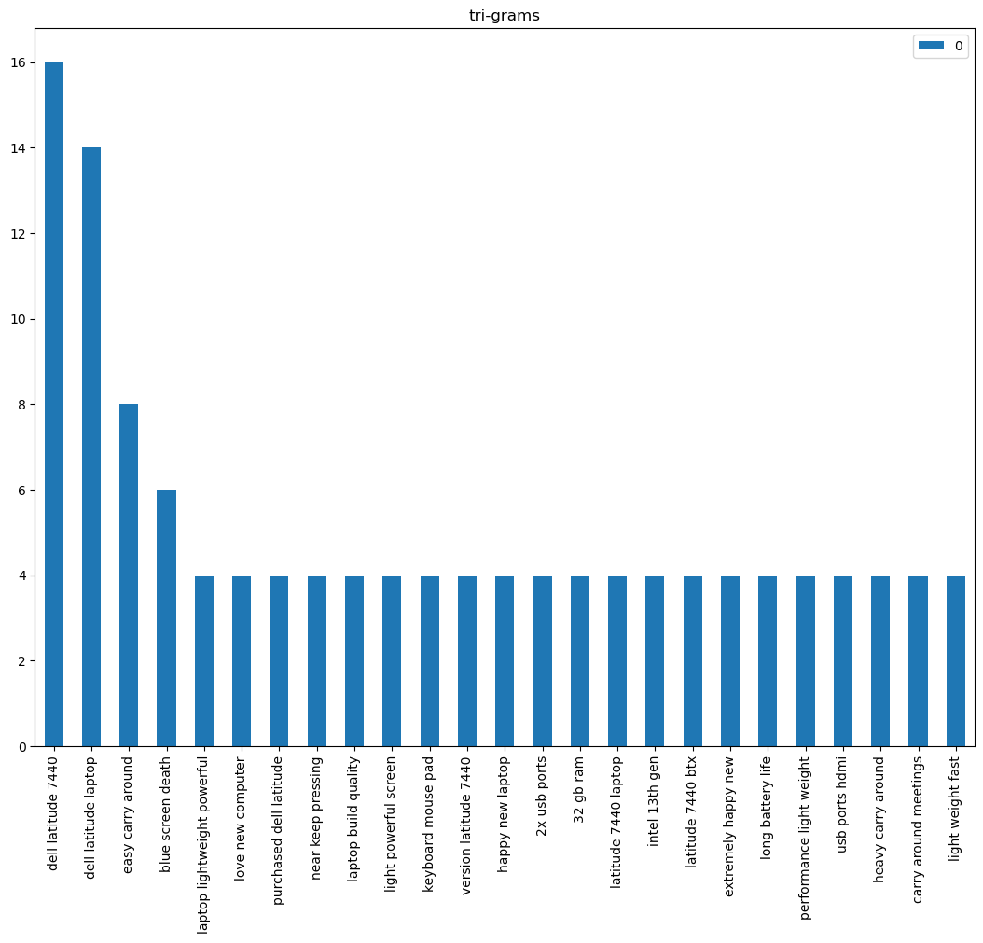
Count vectorizer(Contd)
Bigram:is a two-word sequence of words.
Trigram: is a three-word sequence of words.

Slide 25
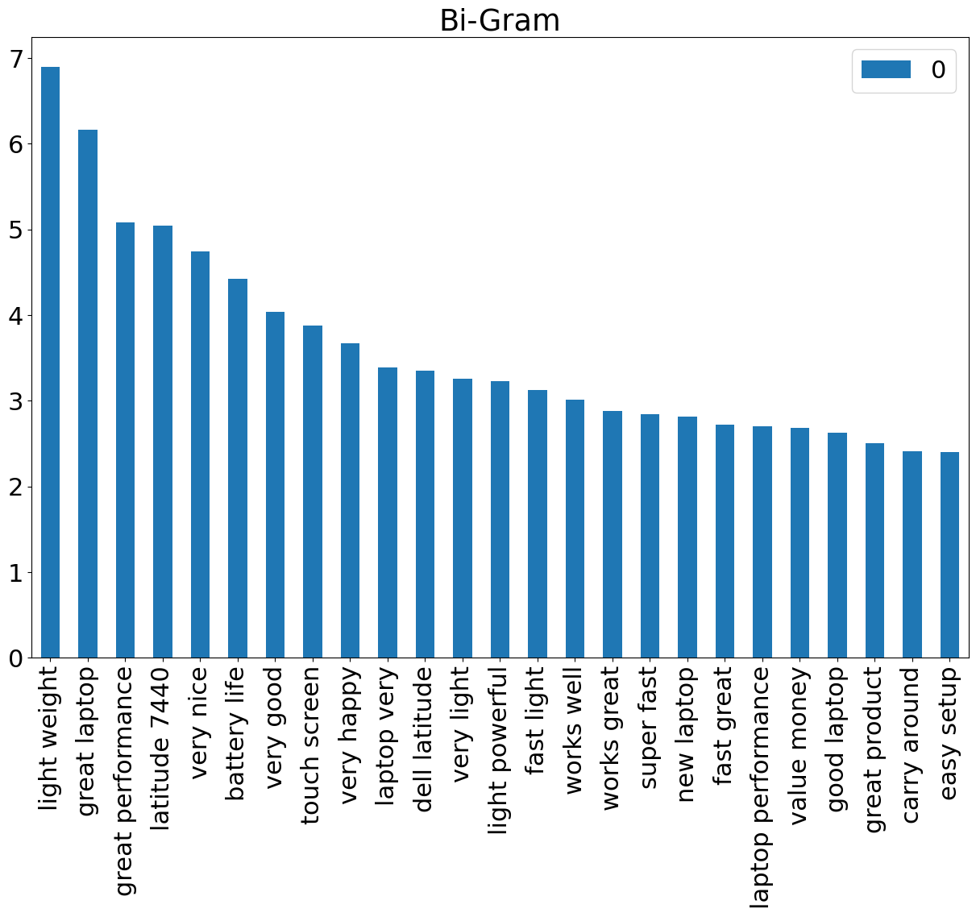
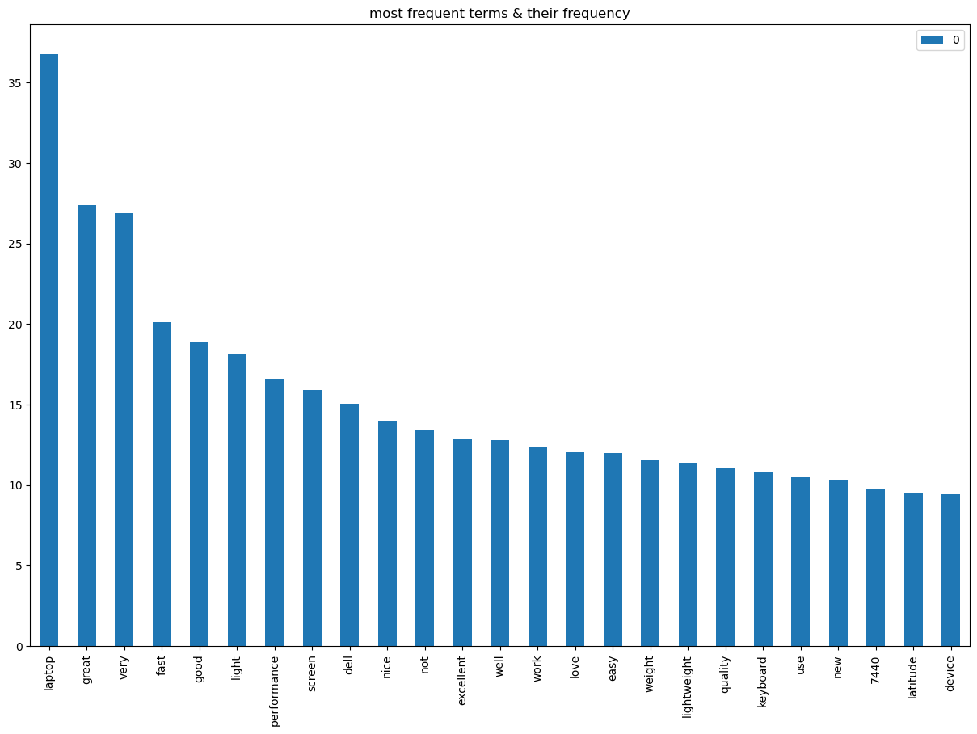
Term Frequency with TFIDF
TFID stands for Term Frequency Inverse Document Frequency of records. The meaning increases proportionally to the number of times in the text a word appears but is compensated by the word frequency in the corpus (data-set).

Slide 26
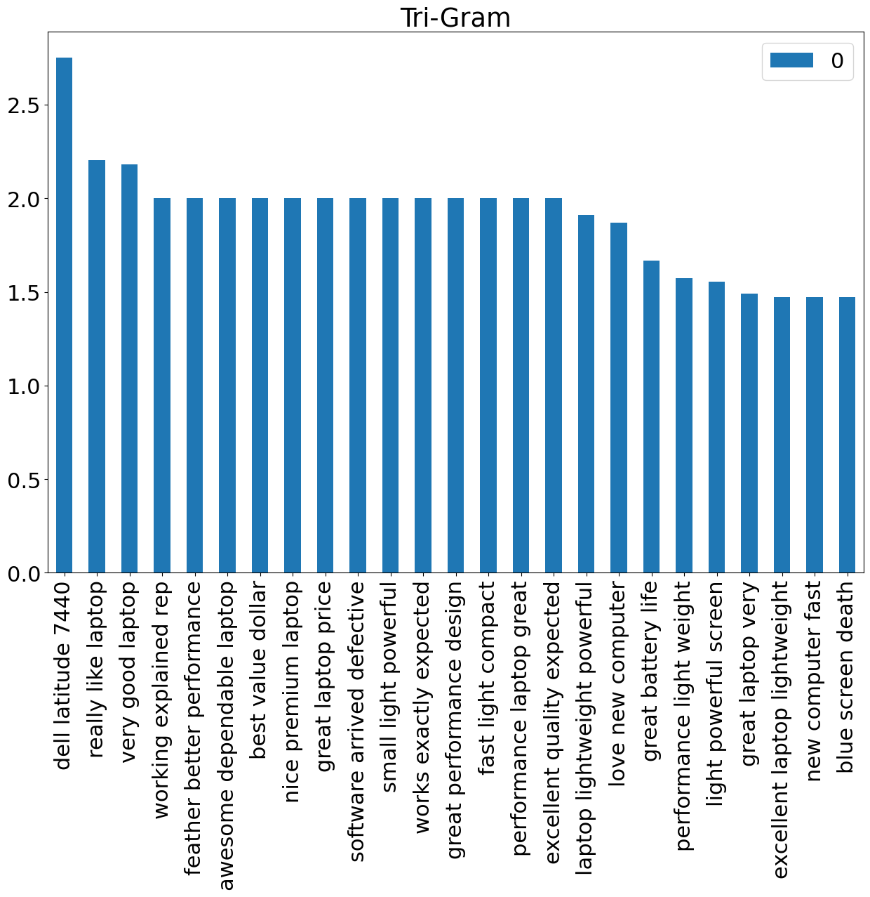
Term Frequency with TFIDF

Slide 27
Sentiment Analysis & Models Evaluated
Vader-Lexcion based
Affin-Lexcion based
Machine learning Based
Logistic Regression
Decision Tree
Naives' Bayes Classifier
Support Vector Machine
KNN
Random Forests
Support Vector Machine
Ensemble Methods
Ada Boost
Extreme Gradient Boosting

Slide 28
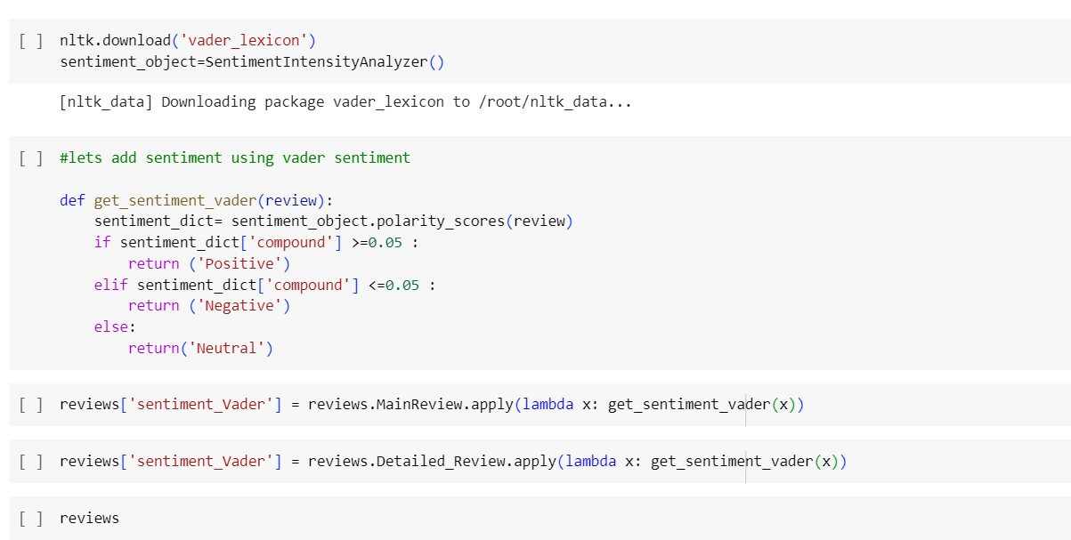
Vader-Lexicon based

Slide 29
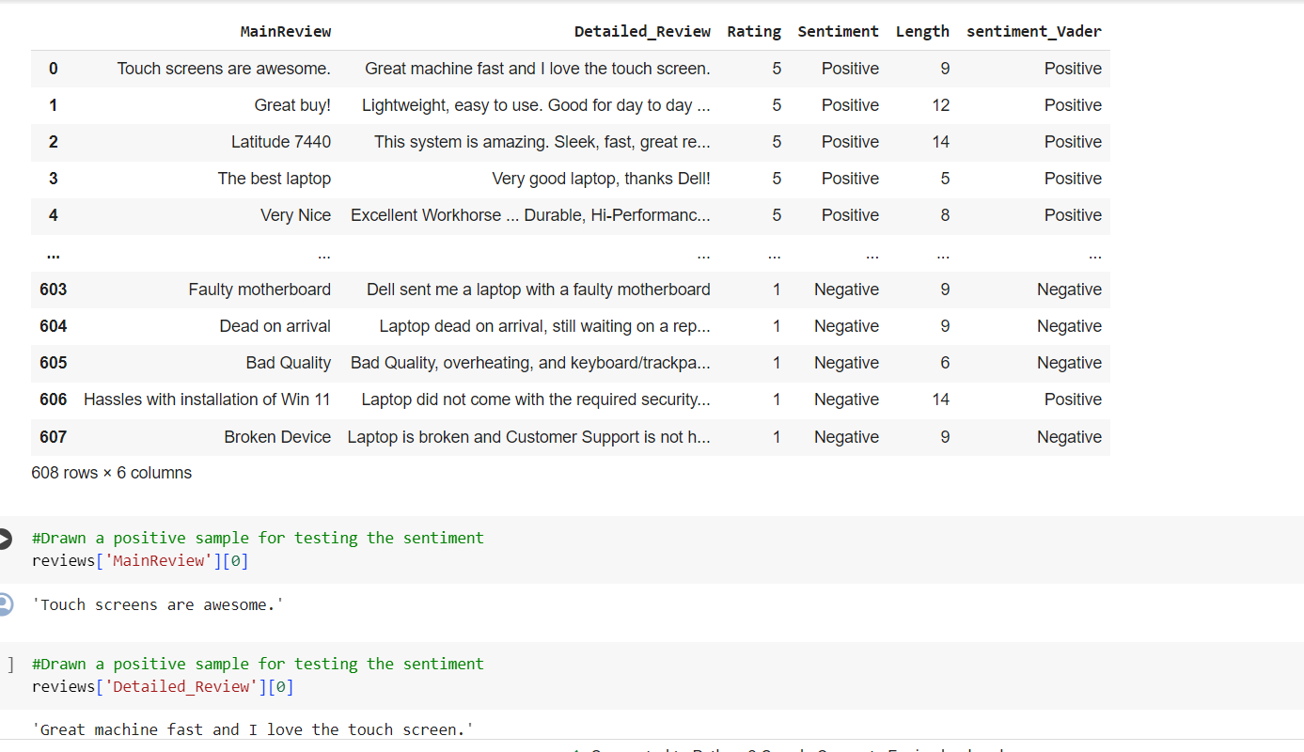
Vader-Lexicon based(contd)

Slide 30
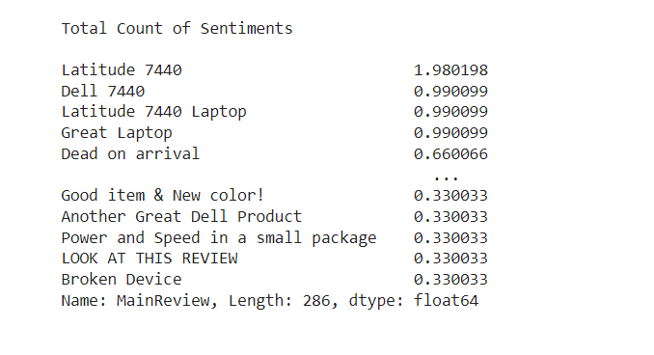
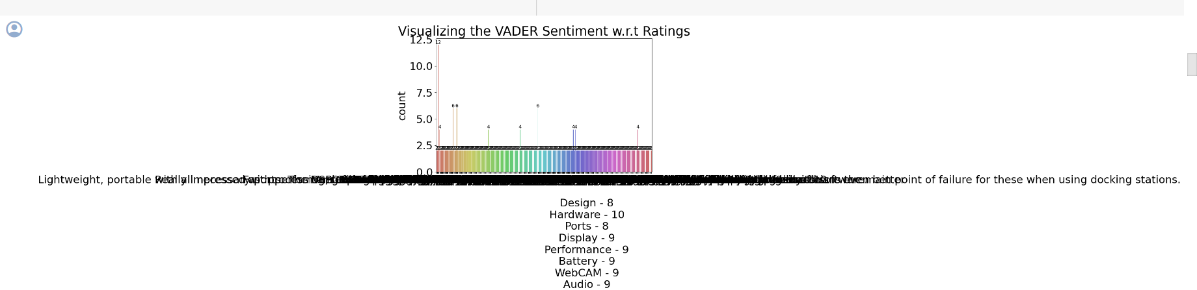
Visualization of Vader

Slide 31
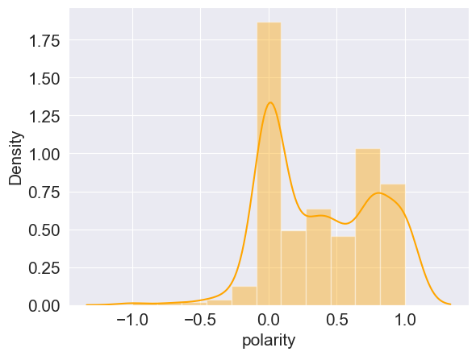
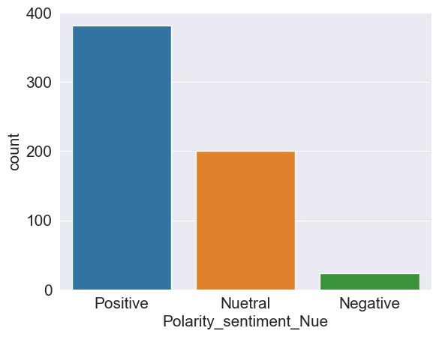
Polarity Sentiment Analysis
Polarity score
The count of sentiment labels

Slide 32
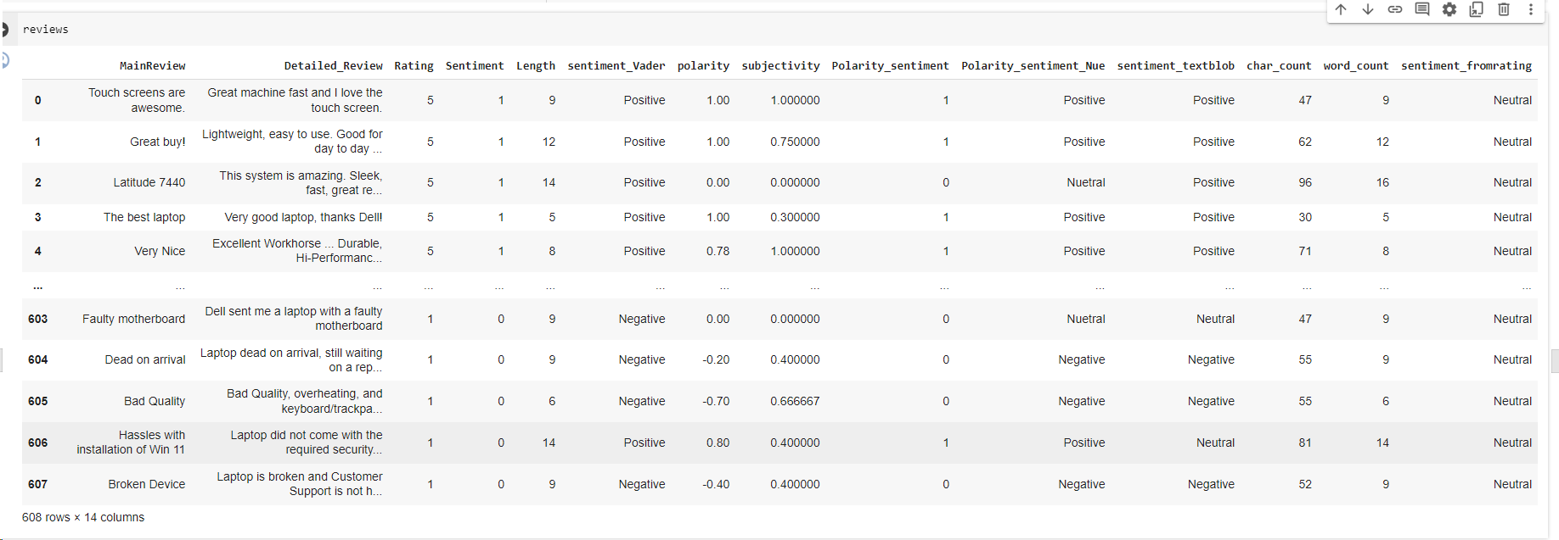
Polarity Sentiment Analysis(contd)

Slide 33
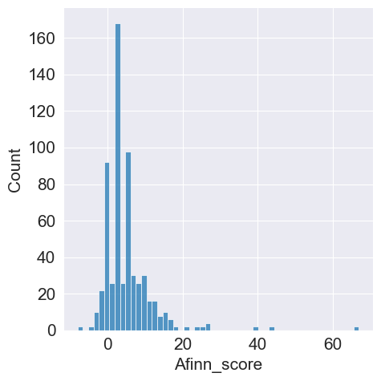
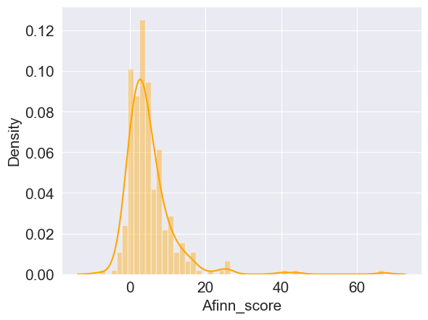
Affin Lexicon based

Slide 34
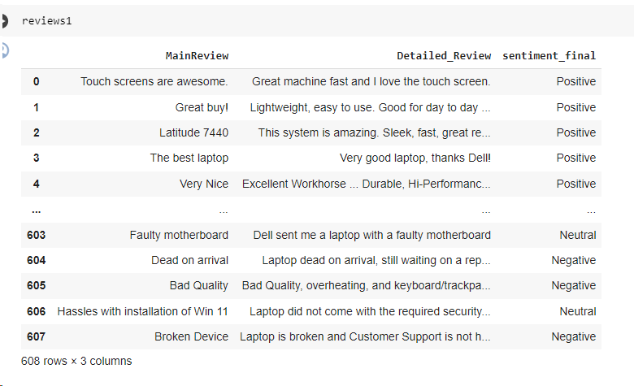
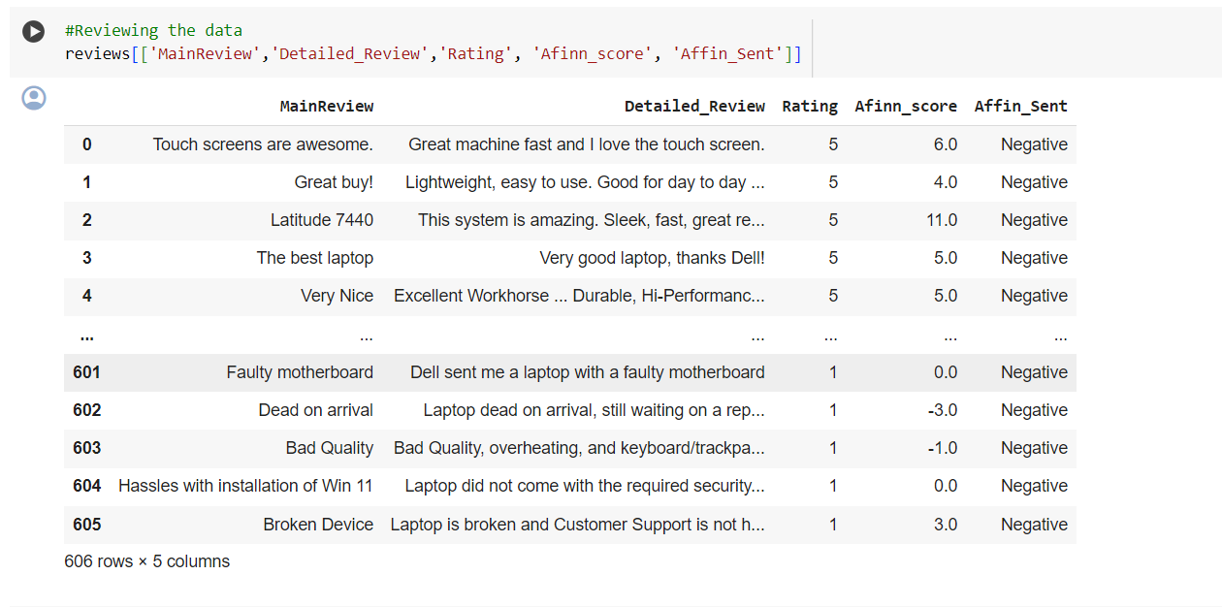
Affin-Lexicon based(contd)

Slide 35
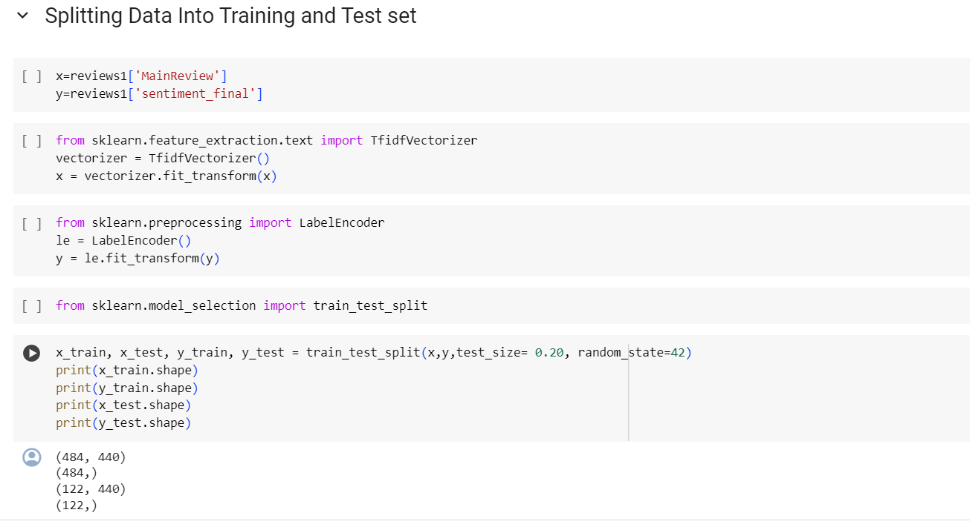
Model Validation

Slide 36
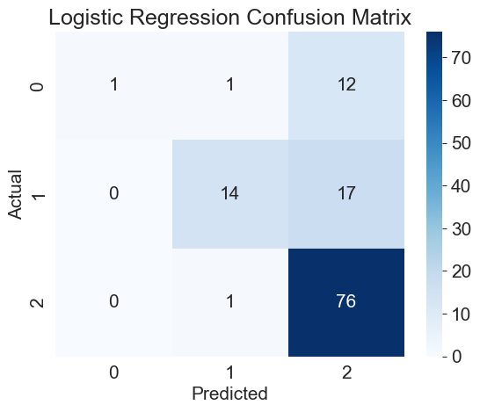
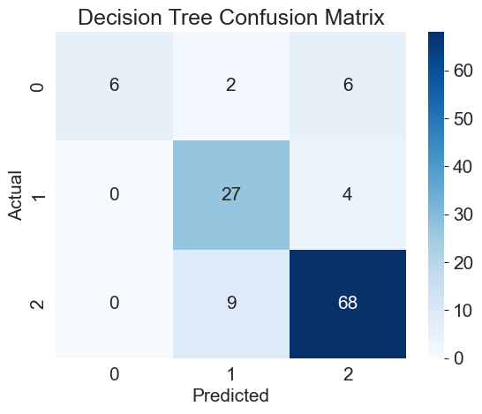

Machine Learning model based
Confusion matrix

Slide 37



Machine Learning model based(contd)

Slide 38



Machine Learning model based(contd)

Slide 39

Metrics

Slide 40

Selecting the best model

Slide 41

Model Deployment & Result

Slide 42

Model Deployment & Result(contd)

Slide 43


